Slide 1
Collective-Capable AXI4 NoC Target Specification
Revision 0.2, 2026-07-23, draft

Slide 2
MHA dataflow requirements for the NoC
MHA dataflow demand
High bandwidth : Q, K, V multicast, activations, KV cache blocks
Burst-based
Latency sensitive : Softmax statistics, synchronization, scheduler start and done
Single-beat messages
Control message: Requests, acknowledgments
Small fixed-size flits
NoC design goal
Traffic-class isolation
High Bandwidth traffic
Latency-sensitive traffic
Collective-Capable NoC for Large-Scale Accelerators
Multiple flexible configuration options

Slide 3
Key features
512 b data, 64 GB/s @ 1 GHz
Header overhead 7 %
Three physical networks REQ / RSP / DAT
REQ/RSP full-duplex W/R utilization 81.4 % on DAT
Support AXI Outstanding / Interleaving / Out-of-Order
2x2 to 16x16 mesh, 256 nodes
Write multicast / Response reduction support
1 to 8 virtual channels, credit-based on DAT, ready/valid on REQ / RSP
XY wormhole, deadlock-free
GALS, per-endpoint clocks

Slide 4
How to handle heterogeneous traffic
High Bandwidth traffic
DMA traffic
Wide busses (512-bit)
Burst-based
Large messages (few kBs)
Latency tolerant
Control traffic traffic
Request messages
Acknowledgment messages (AXI write responses)
Small messages
Latency-sensitive traffic
Core traffic
Synchronization
Single-word messages
Wide links
with high utilization
Narrow links with
low utilization
Wide
Wide
Req
Req
Rsp

Slide 5
AXI to Physical link mapping
AXI4 requests and responses are always transmitted over separate physical links to avoid message-level deadlocks. The REQ and RSP links are mainly used to handle latency-sensitive requests and responses from compute cores.
REQ/RSP links are utilized for read requests and write responses from the wide AXI4 bus, as these messages do not fully utilize the bandwidth of a wide link. By mapping them to narrow links, the wide link is reserved for high-bandwidth traffic, such as read and write bursts.
 |  | Mapping & primary payload
Physical link | Size | Narrow class | Data class
REQ | 137b | AW, AR: 48 b address W: 64 b data | AR: 48 b address
RSP | 127b | R: 64 b data B: 2 b response | B: 2 b response
DAT | 629b | - | AW: 48 b address W, R: 512 b data

Slide 6
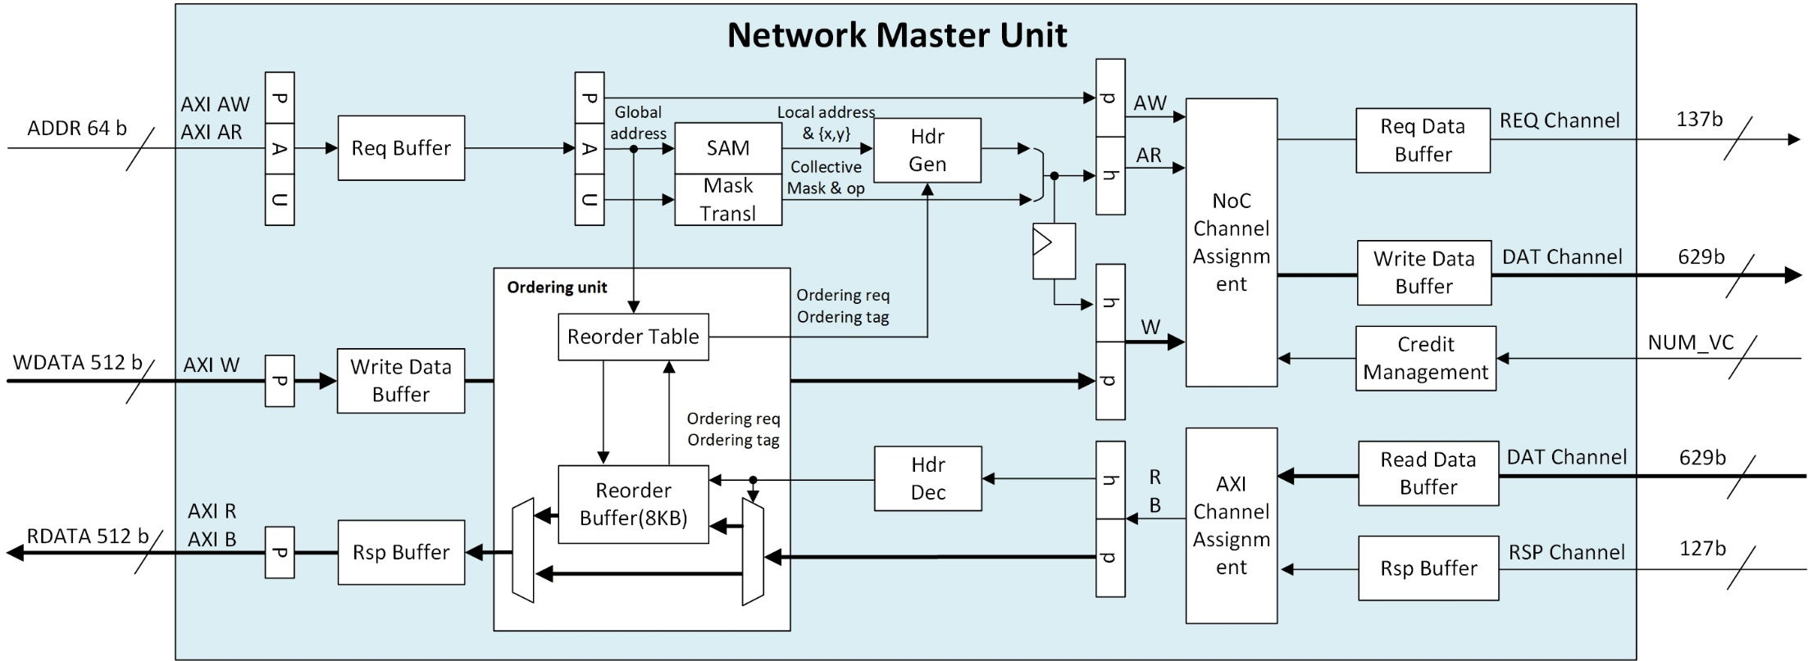
NMU (Network Master Unit)
Request path
Round-robin arbitration with wormhole lock
SAM(System Address Map)
Global Address Translate to Local Address
Response path
Reorder buffer: 8 KB SRAM, two responses at the AXI 4 KB maximum burst
Same-ID ordering: same-destination streams bypass the reorder buffer

Slide 7
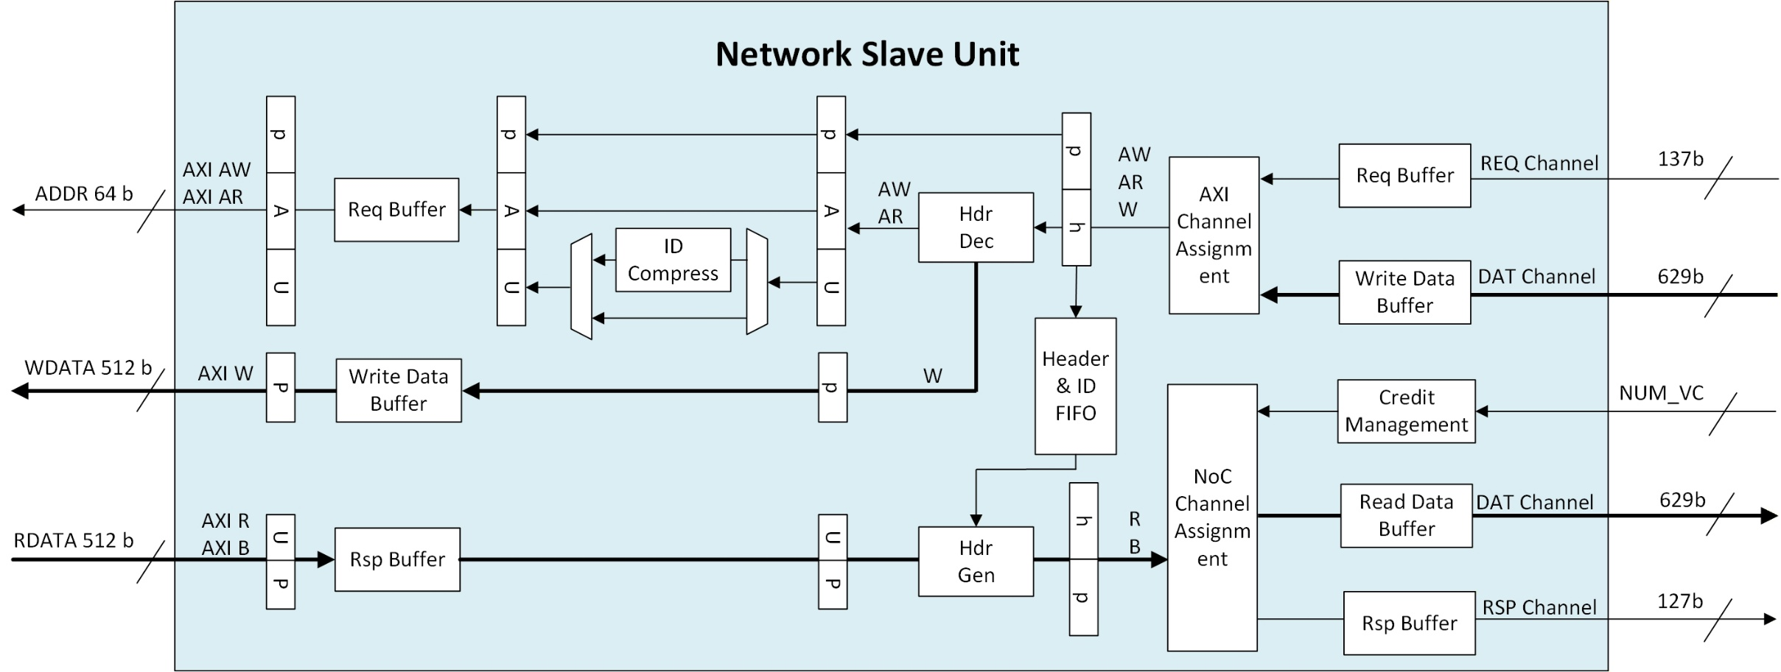
NSU (Network Slave Unit)
Request path
Packet buffer
ID compression: narrower downstream ID width
Streams sharing a compressed ID return in order
Response path
Header FIFO: header kept for response packetization

Slide 8
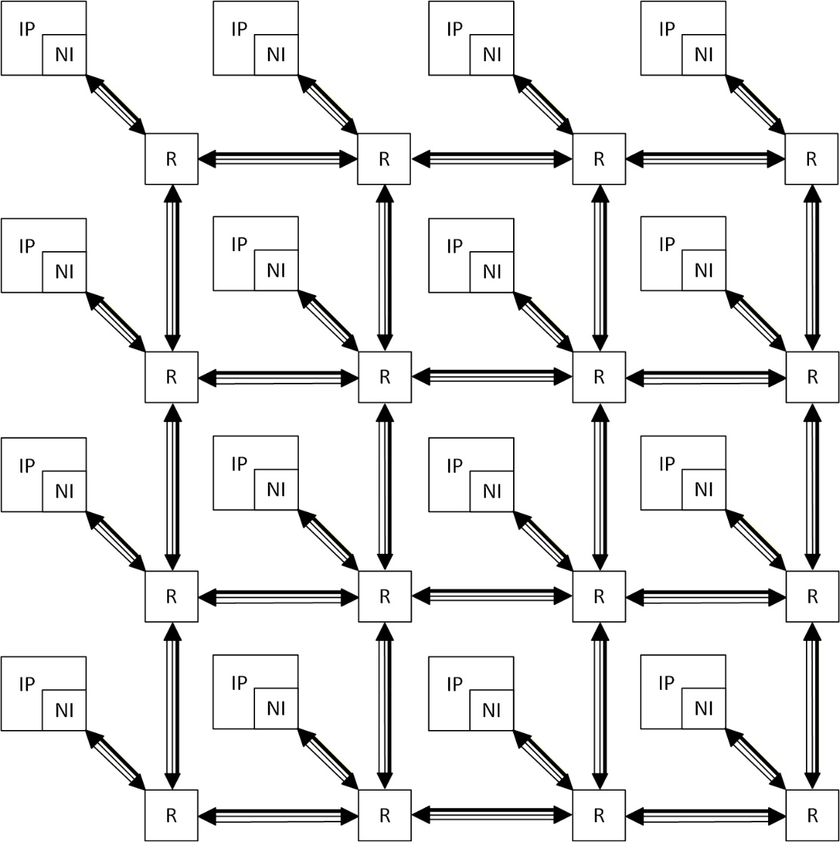
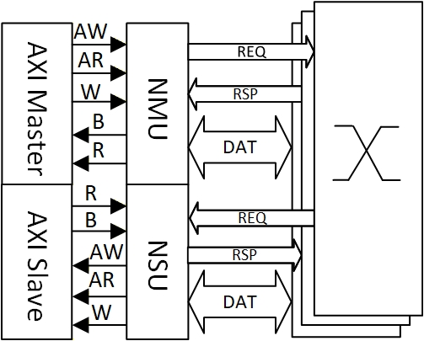
Architecture
Each node holds one compute tile and its local memory, so it is both an AXI master and an AXI slave
XY routing fixes the path a multicast takes, its merged response retraces that path in reverse

Slide 9
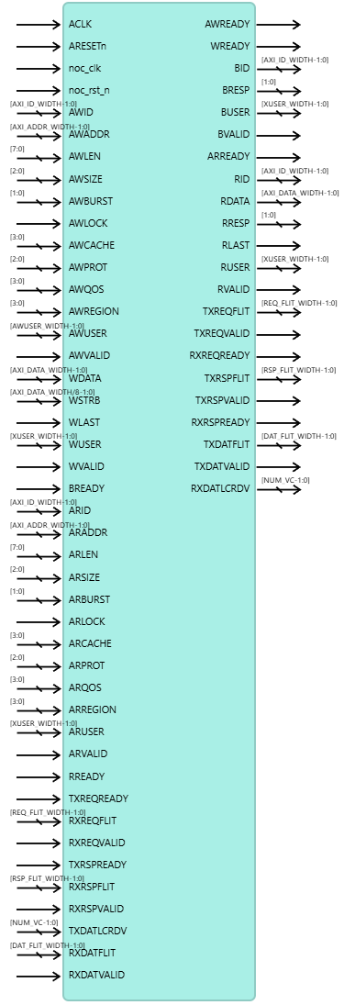
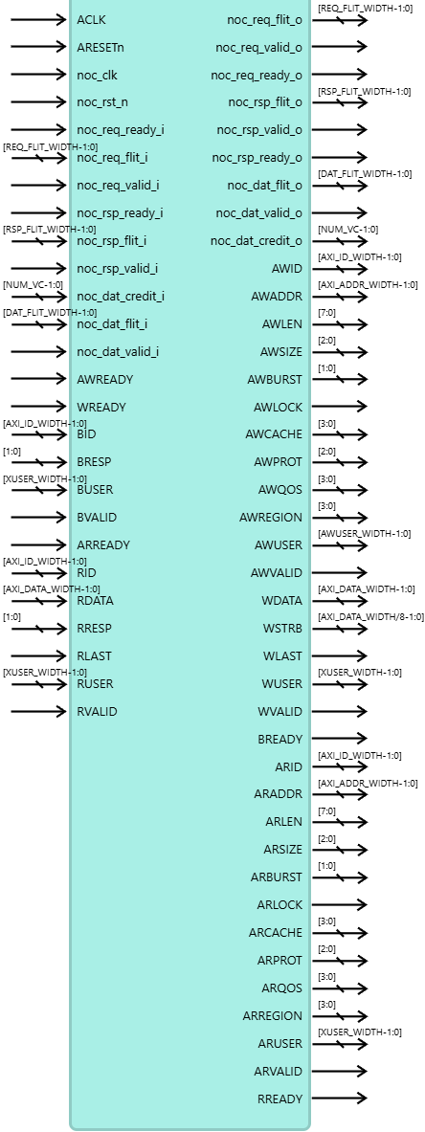
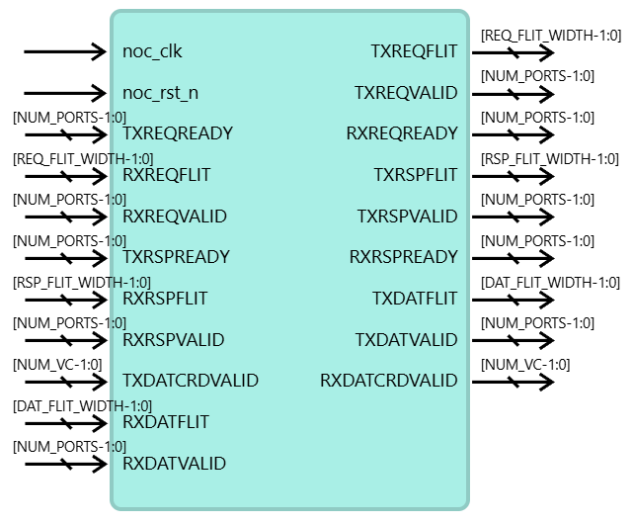
NI & Router Interfaces
Unit | AXI interface | NoC interface
NMU | AXI slave interface | NoC initiator interface
NSU | AXI master interface | NoC target interface
Router | - | NoC link interface per port, one local and four directional (N, E, S, W)

Slide 10
AXI channel signals
One AXI4 channel set for NMU and NSU, widths per the spec.
Channel | Signals | Key widths
Write address AW | AWID, AWADDR, AWLEN, AWSIZE, AWBURST, AWLOCK, AWCACHE, AWPROT, AWQOS, AWREGION, AWUSER, AWVALID, AWREADY | AWADDR 48, AWID 8, AWUSER 58
Write data W | WDATA, WSTRB, WLAST, WUSER, WVALID, WREADY | WDATA 64 or 512, WSTRB 8 or 64
Write response B | BID, BRESP, BUSER, BVALID, BREADY | BID 8, BRESP 2, BUSER 8
Read address AR | ARID, ARADDR, ARLEN, ARSIZE, ARBURST, ARLOCK, ARCACHE, ARPROT, ARQOS, ARREGION, ARUSER, ARVALID, ARREADY | ARADDR 48, ARID 8, ARUSER 8
Read data R | RID, RDATA, RRESP, RLAST, RUSER, RVALID, RREADY | RDATA 64 or 512, RRESP 2

Slide 11
NoC link interface
Each link carries the three physical networks, each an independent signal group per direction
Network | Flit width | Flow control
REQ | 137 | valid and ready, one instance per direction
RSP | 127 | valid and ready, one instance per direction
DAT | 629 | valid plus per-virtual-channel credit return, no ready

Slide 12
NoC Communication Protocol – Flit header
Field | Bits | Width | Description
axi_ch | [3:0] | 4 | AXI channel of the flit. 0: NarrowAw, on REQ 1: NarrowW, on REQ 2: NarrowAr, on REQ 3: NarrowB, on RSP 4: NarrowR, on RSP 5: DataAw, on DAT 6: DataW, on DAT 7: DataAr, on REQ 8: DataB, on RSP 9: DataR, on DAT
src_id | [11:4] | 8 | Source node id, composed as {y[3:0], x[3:0]}
dst_id | [19:12] | 8 | Destination node id, same composition
fixed_vc | [20] | 1 | Holds vc_id end to end, no per-hop reallocation.
vc_id | [23:21] | 3 | Virtual channel index, 0 to the configured VC count minus one
flit_tail | [24] | 1 | Indicates the last flit of a packet
ordering_req | [25] | 1 | When asserted, ordering_tag is valid
ordering_tag | [33:26] | 8 | Reorder slot handle, allocated per transaction. Bounds a master to 256 outstanding transactions
collective_op | [35:34] | 2 | Collective operation. 0: UNICAST, single destination, collective_mask zero 1: MULTICAST, replicate a request to the node set of collective_mask, merge its responses, error BRESP first 2-3: reserved Write path only
collective_mask | [43:36] | 8 | Derived from the AWUSER address mask

Slide 13
Flit payload, requests and write data
Aw, Ar, 93 b | Bits | Width
id | [7:0] | 8
addr | [55:8] | 48
len | [63:56] | 8
size | [66:64] | 3
burst | [68:67] | 2
cache | [72:69] | 4
lock | [73] | 1
prot | [76:74] | 3
region | [80:77] | 4
qos | [84:81] | 4
user | [92:85] | 8
NarrowW, 81 b | Bits | Width
last | [0] | 1
user | [8:1] | 8
strb | [16:9] | 8
data | [80:17] | 64
DataW, 585 b | Bits | Width
last | [0] | 1
user | [8:1] | 8
strb | [72:9] | 64
data | [584:73] | 512

Slide 14
Flit payload, responses and AWUSER
B, 18 b | Bits | Width
id | [7:0] | 8
resp | [9:8] | 2
user | [17:10] | 8
NarrowR, 83 b | Bits | Width
last | [0] | 1
id | [8:1] | 8
resp | [10:9] | 2
user | [18:11] | 8
data | [82:19] | 64
DataR, 531 b | Bits | Width
last | [0] | 1
id | [8:1] | 8
resp | [10:9] | 2
user | [18:11] | 8
data | [530:19] | 512
AWUSER, 58 b | Bits | Width
user | [7:0] | 8
collective_op | [9:8] | 2
collective_mask | [57:10] | 48

Slide 15
Header overhead and W/R utilization
Header overhead counts the 44 b header over the flit width. W and R utilization count the AXI data field over the flit width.
Data utilization counts the AXI data field alone.
Network | Header overhead | W utilization | R utilization
REQ 137 b | 32.1 % | 46.7 %, NarrowW | -
RSP 127 b | 34.6 % | - | 50.4 %, NarrowR
DAT 629 b | 7.0 % | 81.4 %, DataW | 81.4 %, DataR
DataAw rides DAT for ordering, not size: AXI4 write data carries no ID, a slave pairs data with requests by arrival order, so the request travels bundled ahead of its data. The cost is one flit per write burst and amortizes over the burst length.

Slide 16
Configuration options
Feature | Parameter | Values (default) | Comments
Topology | Mesh X and Y dimension | 2-16 (4) | Square meshes only. 256 nodes maximum, set by the 8-bit node ID
AXI interface | Endpoint interfaces | 1, 2 (1) | One interface carries both classes, with the class selected by the SAM address space. Two carry one class each
Flow control | NUM_VC, virtual channels per network channel | 1-8 (1) | Sets the NoC link interface credit signal width
Ordering | Outstanding depth | 1-32 (32) | 1 when same-ID response reordering is disabled. A master holds at most 256 in total, one per ordering_tag, see section 6
Ordering | Re-order buffer | 0,1(1) | The ordering requirement holds in either setting
Address map | SAM address spaces | config, memory | Config space selects the narrow class, memory space the data class. Uniform across nodes, loaded at runtime

Slide 17
Metrics
Metric | Definition
Payload bandwidth | AXI payload the same link carries, data width x clock / 8
Payload efficiency | Data beats over flits carried
Zero-load latency | Packet latency with no queueing and no contention
Sustained bandwidth | Payload bandwidth a channel delivers over a continuous stream
All figures assume AXI and NoC on one 1 GHz clock, the 512 b data class, and 4 KB bursts.

Slide 18
Payload bandwidth
A physical network carries one flit per cycle per direction and a flit holds at most one beat of AXI payload.
AXI interface, per port
Narrow W, R: 64 b @ 1 GHz = 8 GB/s each
Data W, R: 512 b @ 1 GHz = 64 GB/s each
NoC channel, per link direction
REQ: flit 137 b @ 1 GHz = 17.1 GB/s channel, 8 GB/s payload
RSP: flit 127 b @ 1 GHz = 15.9 GB/s channel, 8 GB/s payload
DAT: flit 629 b @ 1 GHz = 78.6 GB/s channel, 64 GB/s payload

Slide 19
Payload efficiency
The bandwidth problem with serialization
Write
Shares DAT with AW+W
One flit per burst
N/(N+1) payload efficiency
Read
Response-direction DAT to itself
No flit shared
100% payload efficiency
Burst length | Payload efficiency
1 beat (64 B) | 50%
4 beats | 80%
16 beats | 94.1%
64 beats (4 KB) | 98.5%

Slide 20
Sustained bandwidth: full rate unless reads reorder
In-order reads hold the full rate, 64 GB/s.
Out-of-order reads lift efficiency across destinations, but the reorder-buffer size is their bottleneck
every reordered response passes through it, and once its 8 KB is fully allocated the next request waits.
Burst size | Outstanding | Pending data (B) | Coverage (cycles) (pending data / 64 B per cycle)
64B | 32 | 2048 | 32
256B | 32 | 8192 | 128
1024B | 8 | 8192 | 128
4096B | 2 | 8192 | 128

Slide 21
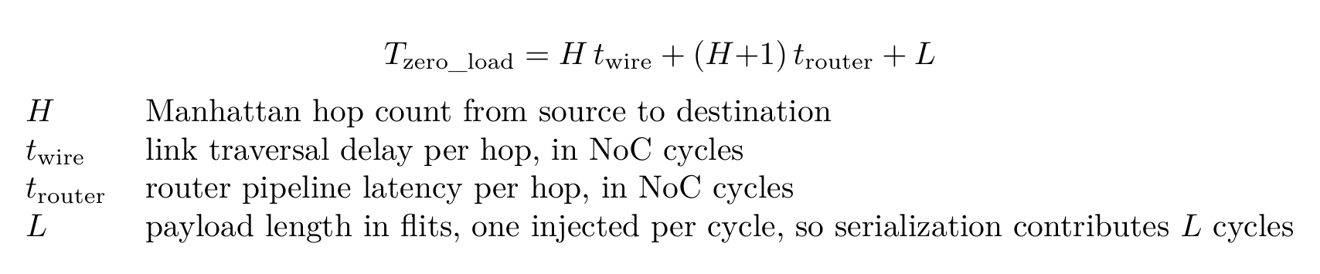
Zero-load latency
A packet crossing H hops traverses H links and passes H + 1 routers, counting the source router.
REQ / RSP: simple-mode router, ready/valid, 1 to 2 pipeline stages per hop
DAT: standard-mode router, multi-VC credit-based flow control, 3 to 5 pipeline stages per hop

Slide 22
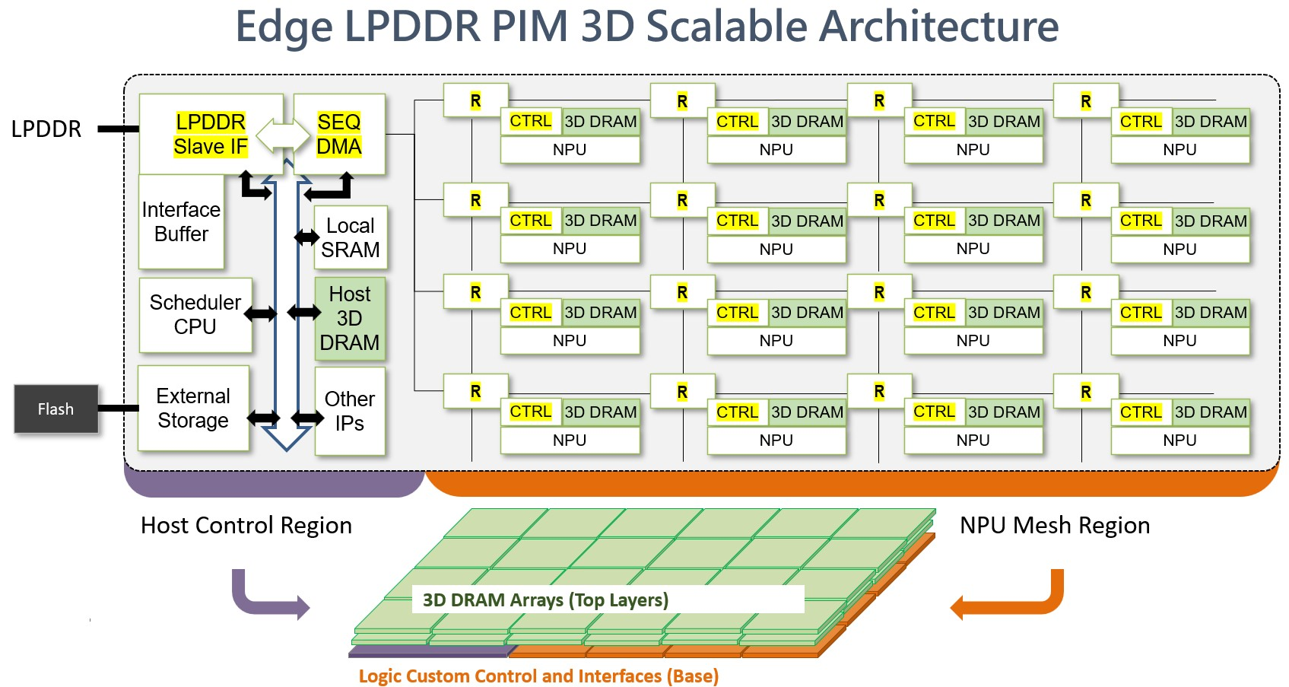
Evaluation Model
The evaluation platform is the Edge LPDDR PIM 3D scalable architecture. The NoC under test is the router mesh and network interfaces of its NPU mesh region.
Host control region: a scheduler CPU and a sequencer DMA stage data from LPDDR and external storage into the mesh
NPU mesh region: one tile per node. A tile holds an NPU, its controller, tile-local 3D DRAM, and a router

Slide 23
Memory tiers, cold storage to compute
Tier | Location | Role
External storage | Host control region, loaded from Flash | Persistent model store, read once at model load
LPDDR | External DRAM behind the LPDDR interface | Capacity tier. Holds the model image and feeds weight staging
Host 3D DRAM | Host control region | Bandwidth tier on the host side. KV cache offload target and sink of mesh output
Interface buffer | Host control region | Staging buffer between the external interfaces and the sequencer DMA
Local SRAM | Host control region | Scheduler working memory, holds DMA descriptors
Tile 3D DRAM | Every mesh tile | Near-memory tier. Resident weights, the tile's Q, K, V, O blocks, and hot KV cache. Tile-local, so a source-tile load generates no NoC traffic
L1 | Inside the NPU | Compute scratchpad. Sub-tiles, partial sums, and online-softmax state, filled by tiling with double buffering

Slide 24
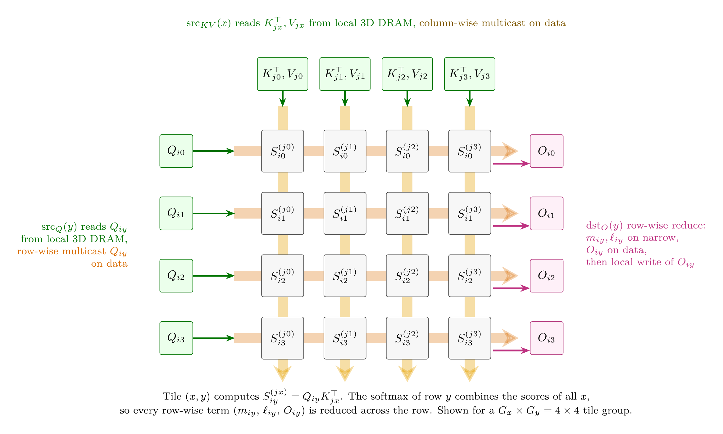
Tiled attention dataflow
Three algorithms specify the dataflow: model-level execution flow at the run level, and the attention block it invokes as per-tile fetch or multicast, differing only in how shared operands reach the tile group.
Attention block mapping
A tile group computes one attention block: the score grid S = Q K^T maps onto the mesh, rows share Q, columns share K/V
Attention block mapping onto a 4 x 4 tile group

Slide 25
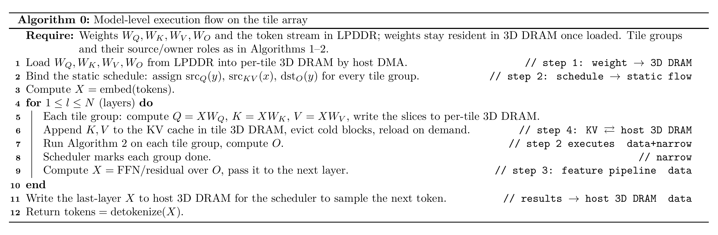
Model-level execution flow
Weights load once into per-tile 3D DRAM and stay resident, no layer fetches weights over the fabric. A layer puts two traffic classes on the fabric:
Feature pipeline: activations passed to the next layer, on the data plane.
Scheduler control: per-group start and done messages, on the narrow control plane.
Layers map to tile groups round-robin as pipeline stages. A group holds the weights and KV cache of its layers, so only the activations X cross group boundaries:

Slide 26
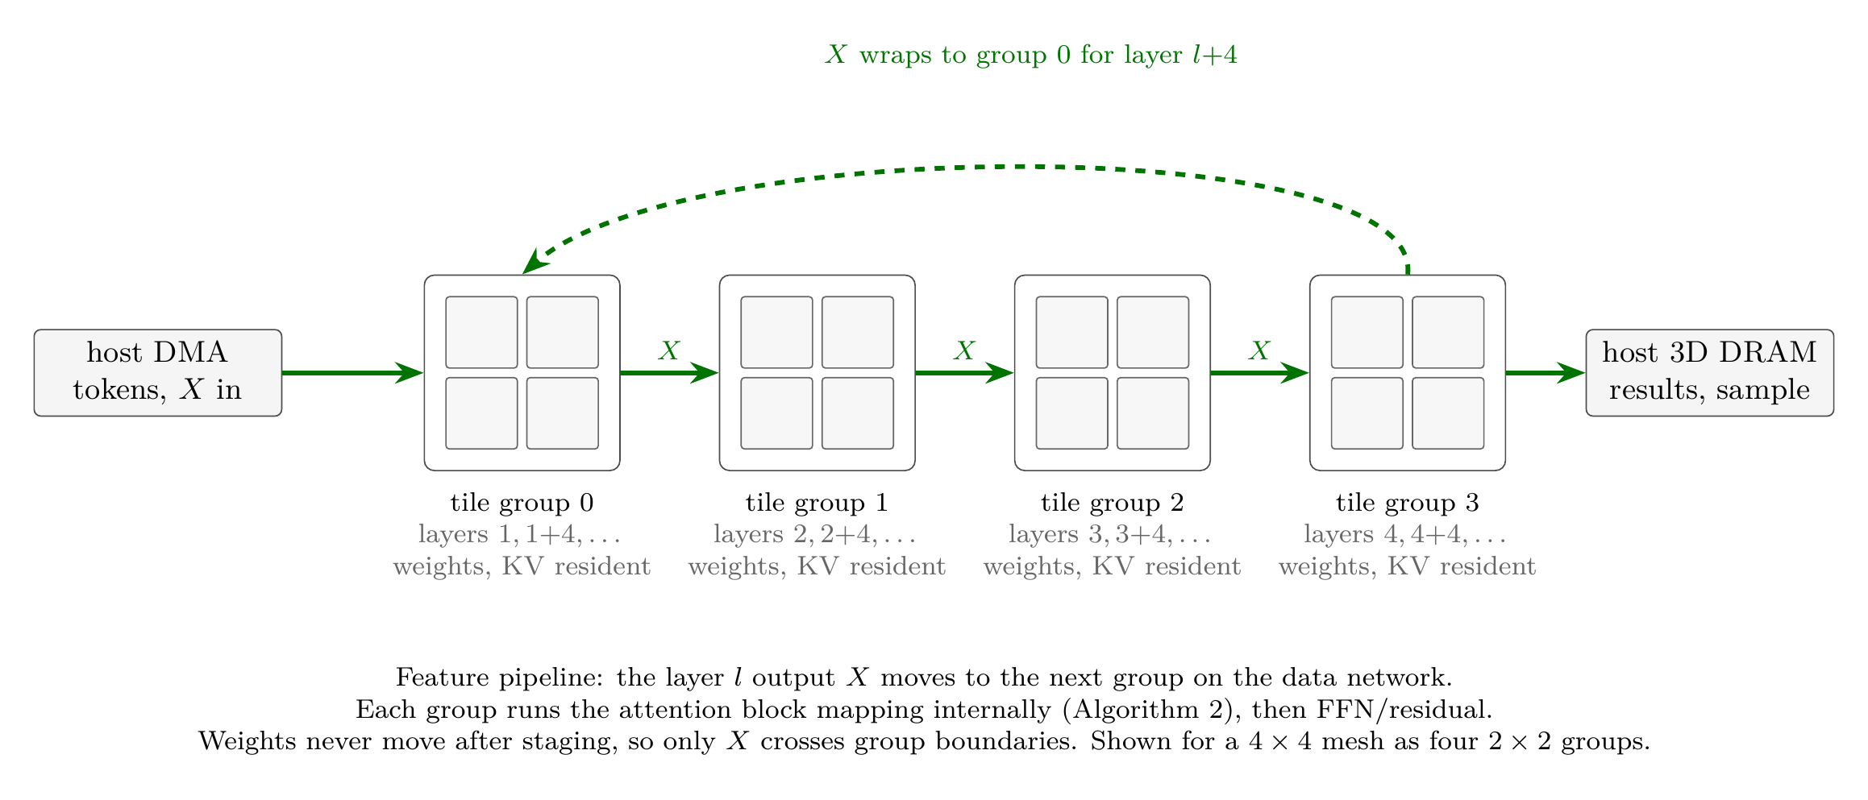
Algorithms 1 and 2
Algorithms 1 and 2 differ in one place, how a shared slice reaches its consumers:
Algorithm 1 (per-tile fetch): every consumer tile pulls the slice itself, Gx unicast reads per Q slice and Gy per K/V slice (lines 5 and 7)
Algorithm 2 (multicast): the source tile reads its slice locally once and multicasts it, one transfer per slice (lines 5-6 and 8-9)
In both figures the comments mark plane use: data for the Q, K, V, O tensors, narrow for the m and l statistics, local read/write for 3D DRAM accesses that generate no NoC traffic.

Slide 27
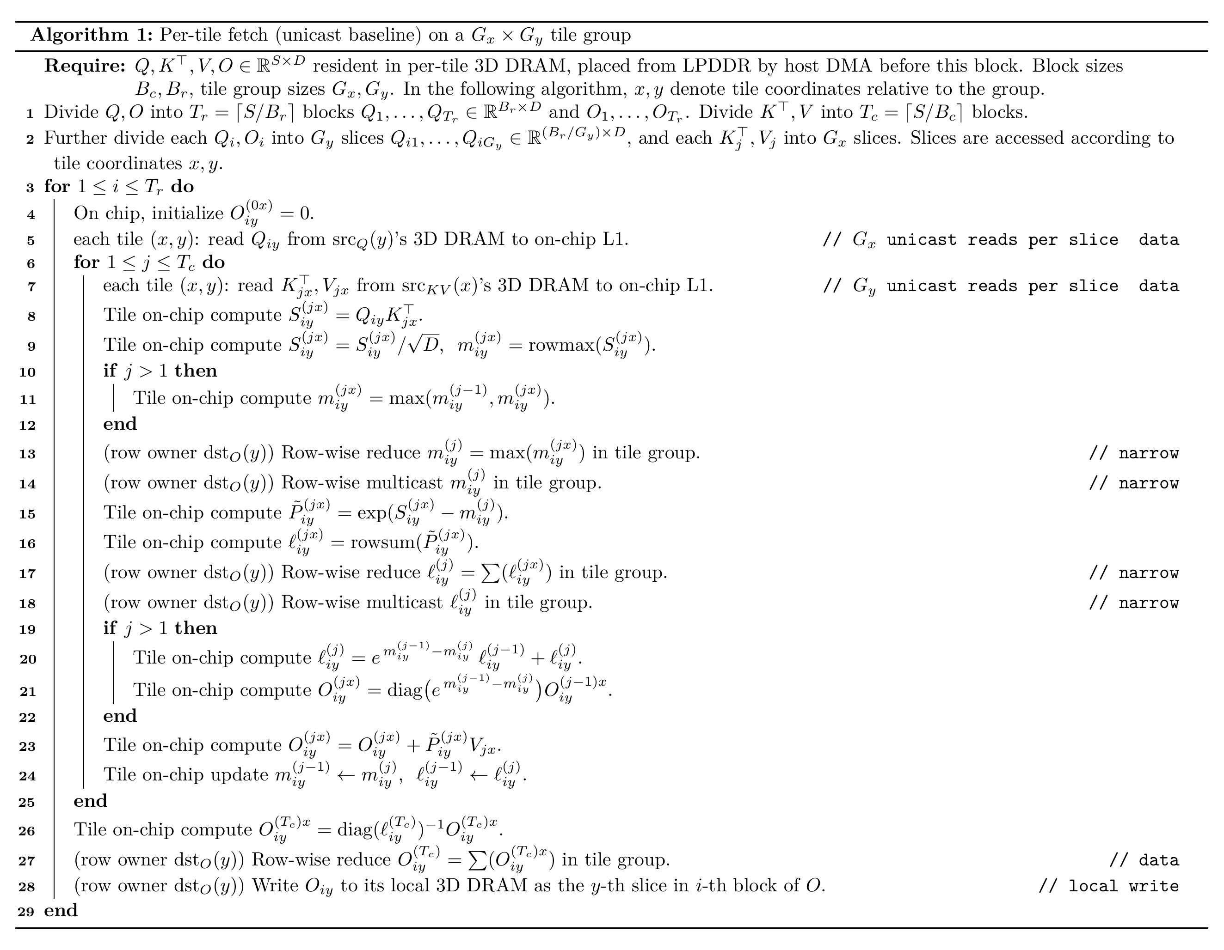
Algorithm 1 Per-tile fetch
Every consumer tile pulls the slice itself, Gx unicast reads per Q slice and Gy per K/V slice.

Slide 28
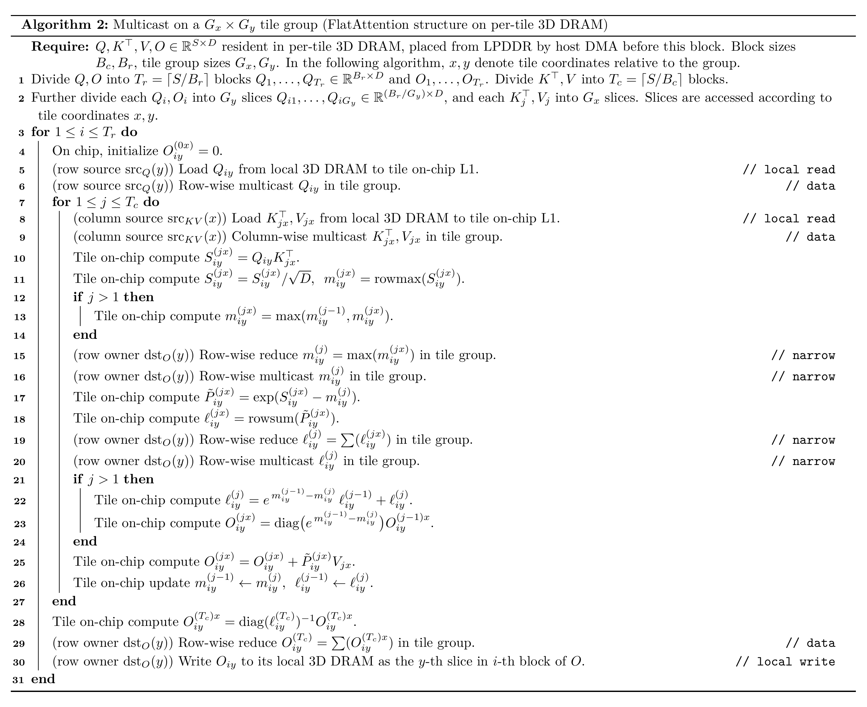
Algorithm 2 Multicast
The source tile reads its slice locally once and multicasts it, one transfer per slice.
Algorithm 2: multicast on a Gx x Gy tile group

Slide 29
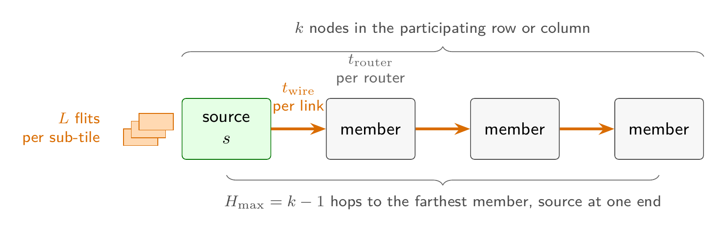
Multicast model and tail latency
The row and column multicasts of Algorithm 2 follow the model below, a multicast along one axis over a set of k nodes. A submesh multicast runs in two phases, one per axis.
Case | Tail arrival at the farthest member
Repeated unicast | (k - 1)L + H_max t_wire + (H_max + 1) t_router
In-network multicast | L + H_max t_wire + (H_max + 1) t_router

